Slide 1
IN-THE-BUILDING SERVICE
Next Sunday the 23rd
9:30am
Please RSVP at summitview.com/sundays
Notes:
3:00

Slide 2
“The Way Home”
Philippians 3:20-21
Notes:
0:00

Slide 3
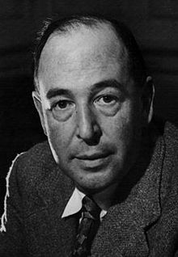
C.S. Lewis
“If we find ourselves with a desire that nothing in this world can satisfy, the most probable explanation is that we were made for another world.”

Slide 4
Romans 8:22-23
²² For we know that the whole creation has been groaning together in the pains of childbirth until now. ²³ And not only the creation, but we ourselves, who have the firstfruits of the Spirit, groan inwardly as we wait eagerly for adoption as sons, the redemption of our bodies.

Slide 7
Notes:
10:00

Slide 8
GOD
LOVING
HOLY

Slide 9
GOD
LOVING
HOLY
JUST

Slide 10
Proverbs 17:15
Acquitting the guilty and condemning the just—both are detestable to the Lord.
Notes:
10:00 (20:00)

Slide 11
Am I really a good person?
We all have done things we deeply regret

Slide 12
Am I really a good person?
We all have done things we deeply regret
Sometimes we avoid blatant sin, not because of our purity, but because of our timidity

Slide 13
Am I really a good person?
We all have done things we deeply regret
Sometimes we avoid blatant sin, not because of our purity, but because of our timidity
Given the right environment, we could all sin in the ways that we despise

Slide 14
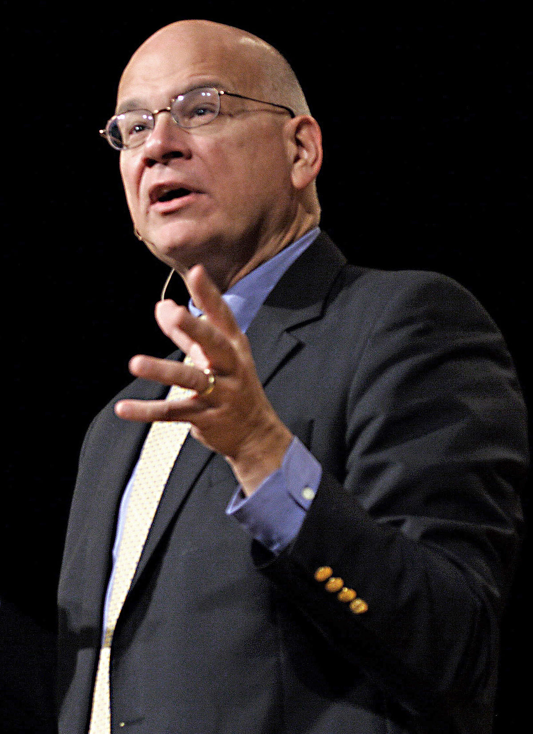
Timothy Keller
“If sin is inside us all we cannot just break the world into heroes and villains.”

Slide 15
Which one wins?
LOVE
HOLINESS
Notes:
6:30 (26:30)

Slide 16
Isaiah 64:6
We have all become like one who is unclean, and all our righteous deeds are like a polluted garment.

Slide 17
Romans 3:20
For by works of the law no human being will be justified in his sight.

Slide 18
Romans 6:23
For the wages of sin is death.
Notes:
4:30 (31:00)

Slide 19
Colossians 1:15, 19-20
¹⁵ He is the image of the invisible God, the firstborn of all creation.
¹⁹ For in him all the fullness of God was pleased to dwell, ²⁰ and through him to reconcile to himself all things, whether on earth or in heaven, making peace by the blood of his cross.

Slide 20
Romans 5:6-11
⁶ For while we were still weak, at the right time Christ died for the ungodly. ⁷ For one will scarcely die for a righteous person—though perhaps for a good person one would dare even to die— ⁸ but God shows his love for us in that while we were still sinners, Christ died for us. ⁹ Since, therefore, we have now been justified by his blood, much more shall we be saved by him from the wrath of God.

Slide 21
Romans 5:6-11
¹⁰ For if while we were enemies we were reconciled to God by the death of his Son, much more, now that we are reconciled, shall we be saved by his life. ¹¹ More than that, we also rejoice in God through our Lord Jesus Christ, through whom we have now received reconciliation.

Slide 22
Receiving the Payment
Repentance (because God is holy)

Slide 23
Receiving the Payment
Repentance (because God is holy)
Faith (because God is loving)

Slide 24
Romans 10:9-10
⁹ because, if you confess with your mouth that Jesus is Lord and believe in your heart that God raised him from the dead, you will be saved. ¹⁰ For with the heart one believes and is justified, and with the mouth one confesses and is saved.

Slide 25
John 3:3
Jesus answered him, “Truly, truly, I say to you, unless one is born again he cannot see the kingdom of God.”

Slide 26
Philippians 3:20-21
²⁰ But our citizenship is in heaven, and from it we await a Savior, the Lord Jesus Christ, ²¹ who will transform our lowly body to be like his glorious body, by the power that enables him even to subject all things to himself.

Slide 27
Hebrews 4:7
Today, if you hear his voice, do not harden your hearts.

